Slide 1
LINUX Introduction

Slide 2
What is Linux?
Just like Windows, Linux is an operating system.
Linux operating system is one of the popular versions of the UNIX operating system, which is designed to offer a free or low cost operating system for personal computer users.
In fact, one of the most popular platforms on the planet, Android, is powered by the Linux operating system.
An operating system is software that manages all of the hardware resources associated with your desktop or laptop.
To put it simply, the operating system manages the communication between your software and your hardware. Without the operating system (OS), the software wouldn't function.

Slide 3
Why use Linux?
Does that operating system you are currently using really work ? Or, do you find yourself battling obstacles like viruses, malware, slow downs, crashes, costly repairs, and licensing fees?
If you struggle with the above, Linux might be the perfect platform for you.
Linux has evolved into one of the most reliable computer ecosystems on the planet.
Combine that reliability with zero cost (Free)of entry and you have the perfect solution for a desktop platform.
Open source
Open source follows these key tenants:
The freedom to run the program, for any purpose.
The freedom to study how the program works, and change it to make it do what you wish.
The freedom to redistribute copies so you can help your neighbour.
The freedom to distribute copies of your modified versions to others.

Slide 4
The Linux operating system comprises several different pieces:
Bootloader – The software that manages the boot process of your computer. For most users, this will simply be a splash screen that pops up and eventually goes away to boot into the operating system.
Kernel – This is the one piece of the whole that is actually called Linux. The kernel is the core of the system and manages the CPU, memory, and peripheral devices. The kernel is the lowest level of the OS.
Daemons – These are background services (printing, sound, scheduling, etc.) that either start up during boot or after you log into the desktop.
Init system – This is a sub-system that bootstraps the user space and is charged with controlling daemons.
etc.

Slide 5
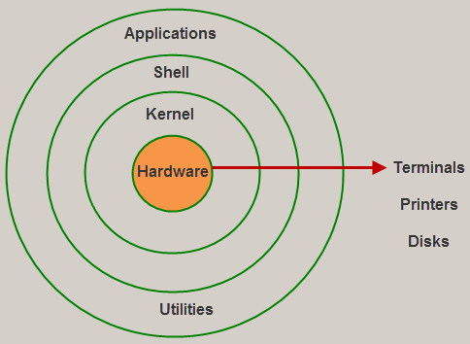
Linux System Architecture
The kernel is the core part of the operating system, which is responsible for all the major activities of the LINUX operating system

Slide 6
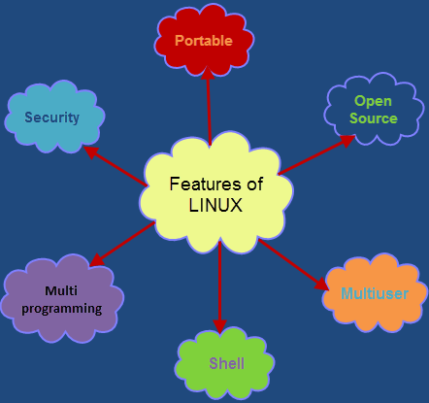
Features of Linux Operating System

Slide 7
Portable: Linux operating system can work on different types of hardware's as well as Linux kernel supports the installation of any kind of hardware platform.
Open Source: Source code of LINUX operating system is freely available and, to enhance the ability of the LINUX operating system, many teams work in collaboration.
Multiuser: Linux operating system is a multiuser system, which means, multiple users can access the system resources like RAM, Memory or Application programs at the same time.
Multiprogramming: Linux operating system is a multiprogramming system, which means multiple applications can run at the same time.
Shell: Linux operating system offers a special interpreter program, that can be used to execute commands of the OS. It can be used to do several types of operations like call application programs, and so on.
Security: Linux operating system offers user security system using authentication features like encryption of data or password protection or controlled access to particular files.

Slide 8
Applications of Linux Operating System
The list of some of popular Linux based electronic devices includes:
Dell Inspiron Mini 9 and 12
Garmin Nuvi 860, 880, and 5000
Google Android Dev Phone 1
HP Mini 1000
Lenovo IdeaPad S9
Motorola MotoRokr EM35 Phone
One Laptop Per Child XO2
Sony Bravia Television
Sony Reader
TiVo Digital Video Recorder
Volvo In-Car Navigation System
Yamaha Motif Keyboard

Slide 9
Popular Linux distributions include:
LINUX MINT
MANJARO
DEBIAN
UBUNTU
ANTERGOS
SOLUS
FEDORA
ELEMENTARY OS
OPENSUSE

Slide 10
The most common Linux commands
Command | Description
cat [filename] | Display file’s contents to the standard output device (usually your monitor).
cd /directorypath | Change to directory.
chmod [options] mode filename | Change a file’s permissions.
chown [options] filename | Change who owns a file.
clear | Clear a command line screen/window for a fresh start.
cp [options] source destination | Copy files and directories.
date [options] | Display or set the system date and tim

Slide 11
df [options] | Display used and available disk space.
du [options] | Show how much space each file takes up.
file [options] filename | Determine what type of data is within a file.
find [pathname] [expression] | Search for files matching a provided pattern.
kill [options] pid | Stop a process. If the process refuses to stop, use kill -9 pid.
less [options] [filename] | View the contents of a file one page at a time.
ln [options] source [destination] | Create a shortcut.
locate filename | Search a copy of your filesystem for the specified filename.
lpr [options] | Send a print job.
ls [options] | List directory contents.

Slide 12
man [command] | Display the help information for the specified command.
mkdir [options] directory | Create a new directory.
mv [options] source destination | Rename or move file(s) or directories.
passwd [name [password]] | Change the password or allow (for the system administrator) to change any password.
ps [options] | Display a snapshot of the currently running processes.
pwd | Display the pathname for the current directory.
rm [options] directory | Remove (delete) file(s) and/or directories.
rmdir [options] directory | Delete empty directories.
ssh [options] user@machine | Remotely log in to another Linux machine, over the network. Leave an ssh session by typing exit.

Slide 13
su [options] [user [arguments]] | Switch to another user account.
tail [options] [filename] | Display the last n lines of a file (the default is 10).
tar [options] filename | Store and extract files from a tarfile (.tar) or tarball (.tar.gz or .tgz).
top | Displays the resources being used on your system. Press q to exit.
touch filename | Create an empty file with the specified name.
who [options] | Display who is logged on.

